Slide 1
MGMT 6055 Project Scope & requirements
Lawrence Kinlin School of Business
Module 4
Notes:
Content for slides in this PPT file is drawn significantly from PMBOK, 6th edition, published by PMI (required text for this course)

Slide 2
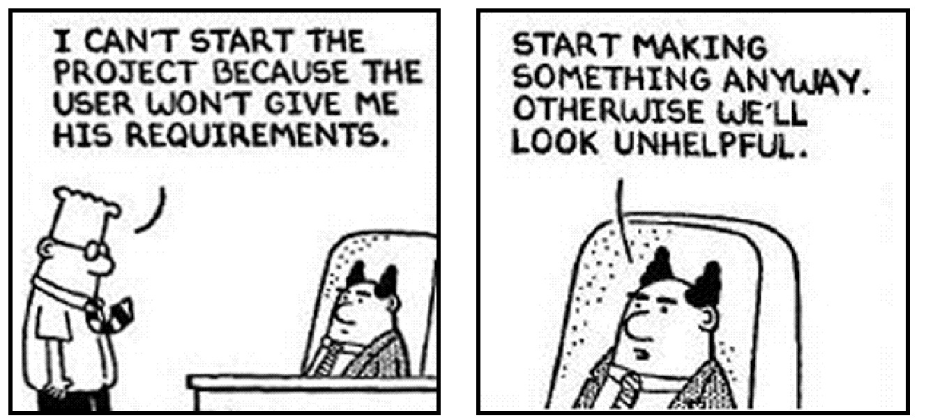
Why Do Projects Fail?
The project manager and project team don’t know what the customer wants…
Notes:
Source: Dilbert (created by Scott Adams)

Slide 3
Learning Objectives
“Collect Requirements” process overview
Business analysts
Collect Requirements: Inputs
Collect Requirements: Tools & Techniques – Data gathering – Interviews, Focus Groups
More tools & techniques and output in the next modules!

Slide 4
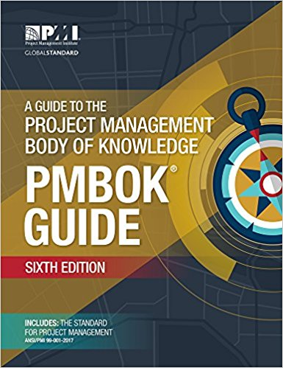
What Do We Mean by Requirements?
Customer
Architectural
Structural
Behavioural
Functional
Non-Functional
Performance
Design
Derived
Source: http://en.wikipedia.org/wiki/Requirements_analysis (excerpt posted in FOL Content, FYI)
See also: http://www.ppi-int.com/systems-engineering/types-of-requirements.php
PMBOK (p. 719): A requirement is a “condition or capability that is necessary to be present in a product, service, or result to satisfy a business need”
There are many different classifications of requirements. Each business organization uses their own categories, but two common ones are FUNCTIONAL and NON-FUNCTIONAL...

Slide 5
Two Common Categories of Requirements
Functional
are observable tasks or processes that must be performed by the system
what the product/deliverable must do
E.g., "must update stock prices”
Non-Functional
qualities or standards that the system under development must have (or any requirements that are not functional req’ts)
E.g., “must run on Windows 7 Operating System (OS)”

Slide 6
The Business Analyst
Identifies and defines solutions that deliver value to stakeholders
Responsibilities include collecting (eliciting), analyzing, managing, and communicating project requirements from stakeholders
Depending on the organization:
May (or may not) be part of the project team
May (or may not) be a specific job title
Should regard the Project Manager as the customer
Business analysts have their own body of knowledge, called BABOK
Video
Notes:
Video : http://www.pcmag.com/encyclopedia_term/0,1237,t=business+analyst&i=39065,00.asp
Slide text from: http://www.iiba.org/Careers/Careers/business-analysis-evolution-of-a-profession.aspx

Slide 7
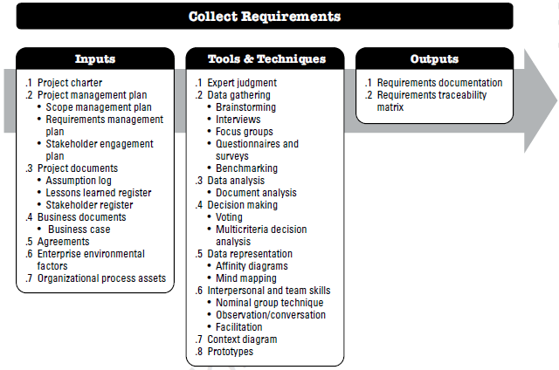
Collect Requirements Process
We’ll explore these ITTOs in Modules 4,5,6, and 7
Notes:
Source: PMBOK 6th ed. (PMI) – Figure 5-4, p. 138
Definition (p. 138): “the process of determining, documenting, and managing stakeholder needs and requirements to meet objectives”

Slide 8
Collect Requirements: Tools and Techniques
Expert judgement (technical subject matter expertise, facilitation expertise, etc.)
Data gathering: interviews, focus groups, questionnaires/ surveys, benchmarking, brainstorming
Data analysis: document analysis
Decision making: voting, multi- criteria decision analysis
Data representation: affinity diagrams, mind mapping
Interpersonal and team skills: nominal group technique, observation/conversation, facilitation (e.g., workshops, collaborative construction of personas, user stories, use case diagrams)
Context diagram
Prototypes
Notes:
Source: PMBOK 6th ed. (PMI)

Slide 9

Tools & techniques: Interviews
Talking directly with stakeholders and or customers
Prepare questions and record the responses
May be informal, structured, or group
Notes:
Image Source: https://www.google.com/url?sa=i&rct=j&q=&esrc=s&source=images&cd=&cad=rja&uact=8&ved=2ahUKEwj_3fj43szdAhXplOAKHRc3AOIQjRx6BAgBEAU&url=https%3A%2F%2Fcareerconfidential.com%2Fultimate-guide-to-job-interview-prep%2F&psig=AOvVaw1Wal7Kzh8xXJ_8_eqaaiF7&ust=1537641450043167

Slide 10

Tools & techniques: Focus Groups
A group of people are asked about their perceptions, opinions, beliefs, and attitudes
Participants share their thoughts and are welcome to comment on, or add to, the thoughts of others in the group
Often, focus groups have the ‘look and feel’ of an open discussion
Ideal size is 8 to 12 participants
Notes:
Image Source: https://www.google.com/url?sa=i&rct=j&q=&esrc=s&source=images&cd=&cad=rja&uact=8&ved=2ahUKEwjNv8yz4MzdAhVrhuAKHQJzB3sQjRx6BAgBEAU&url=https%3A%2F%2Fwww.how-paid-research-works.com%2Fwhat-are-paid-focus-groups&psig=AOvVaw3WLnU9wuP56dt-NtQ1K7Ua&ust=1537641811999068

Slide 11
The Process is the same for conducting Interviews or focus groups
Step 1: Prepare a plan
Step 2: Create questions
Step 3: Conduct interview/focus group
Step 4: Summarize the responses

Slide 12
Step 1: Prepare A Plan
Identify topics to be covered (arrange topics in logical sequence)
Identify participants (How many people? Where/how will you find them? Will they have particular characteristics in common - such as gender, age? Will they have a mix of characteristics – if so, what characteristics do you want to be varied? Consider the inter-personal dynamics of participants for focus groups.)
Schedule interviews/focus groups (How many minutes or hours in duration? Over what time period will they all be completed?)

Slide 13
Step 1: Prepare A Plan (cont’d)
Logistics (Will interviews take place in person, phone, video conference? Will you feed or remunerate focus group participants? Do you need to reserve a meeting room for the interviews/focus groups to take place?)
Create agenda (Prepare a step-by-step checklist of what will take place, e.g., introductions, ask permission to record, explain purpose of interview/focus group, ask questions, ask if they’d like to add final comments, thank participants)
How are you recording the data? (e.g., Voice recorder? An assistant takes notes? You ask questions and write responses?)

Slide 14
Step 2: Create Questions
Open-ended – answers are not pre-determined from a list of possible answers
“What is the most frustrating thing about owning a smartphone?”
“Who or what influences your decision to purchase a specific smartphone model?
Closed-ended – can be answered with “yes/no” or a limited set of possible responses
“Have you ever owned an Apple iPhone?”
“From the following list, which is the most frustrating thing about owning a smartphone: cost, battery life, or cracking the screen?”
You can get lots of rich, detailed responses
You can perform quantitative analysis with responses
Q: Which type of question is better for a focus group? (A: open-ended)
Notes:
Open end can lead to more discussion

Slide 15
Step 2: Create Questions
How much is ‘a lot’? 2 hrs? 5 hrs? 10 hrs?
Don’t use ambiguous words
“Do you study a lot before tests?”
Don’t lead the participant
“What did you think about the poor service at the restaurant?”
Don’t assume that the participant knows what you are talking about
“Which home network security protocol do you prefer to use: WEP, WPA, WPA2, or WPA3?”
Answers will likely be negative
Be prepared to clarify the question
Notes:
Open end can lead to more discussion

Slide 16
Step 3: Conduct Interview/FOCUS GROUP
Introduce yourself
Explain the purpose of the interview/focus group
Ask permission to record the data (you must take notes by hand if permission is not given)
Conduct the interview/focus group
Be prepared to ask spontaneous follow-up or probing questions (in addition to your list of prepared questions)
For Focus Groups: Don’t let any person dominate the discussion, ensure that everyone has an opportunity to share their thoughts
Summarize the topic and then ask: “Is there anything I have overlooked?” or “Is there anything more you’d like to add that we haven’t covered?”
Thank the participant
This is a good outline for an agenda

Slide 17

Step 3: Conduct Interview/FOCUS Group
THE MOST IMPORTANT THING TO DO IS….
LISTEN…!!!!!!!
Don’t finish their answer, interrupt or “talk over” them while they’re speaking
Let THEM do most of the talking!
Notes:
Image Source: https://www.google.com/url?sa=i&rct=j&q=&esrc=s&source=images&cd=&cad=rja&uact=8&ved=2ahUKEwi7wv6p7szdAhWym-AKHR4aBrQQjRx6BAgBEAU&url=https%3A%2F%2Fwww.wikihow.com%2FListen&psig=AOvVaw1R8xiu39HvgsScwP9Ki2Kx&ust=1537645558008781

Slide 18

Step 4: summarize responses
Document results immediately after the session(s)
Voice recording? Prepare a written summary
Written notes? Organize/edit/format them
Add personal observations to your summary (e.g., “participant was confused and asked me to re-phrase this question” or “participant had a confused look on her face when responding to the question”)

Slide 19
Focus group Example – New Product Development
https://www.youtube.com/watch?v=71U_kx290Ts (R &D process uses multiple tools and techniques)
https://www.youtube.com/watch?v=MuiI7BFhQl4 (Pkging for salad dressing – 4:17)

